Slide 1


Guidance Presentation
Event Reporting:
Safety Suggestions/Positive Safety Observations
Press any key to continue

Slide 2
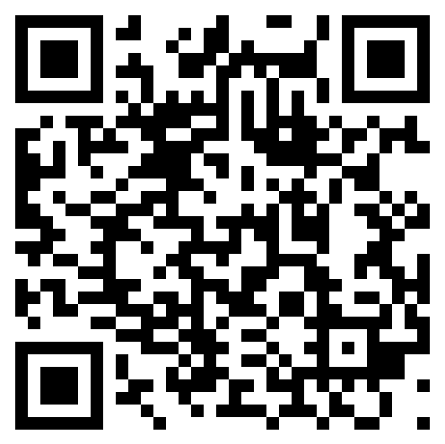
Adding a Safety Suggestion/Positive Safety Observation for unlicensed users
1. Loading the first report screen
Loading the first report screen
Selecting the correct module
Filling in your details
Filling in the report
Review and submit
Scan the above QR code on your mobile device to open the Sphera first report page.
To open the first report screen on a PC or Laptop, goto the link below:
Reportasafetyevent.quanex.com
Prev
Next

Slide 3
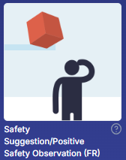
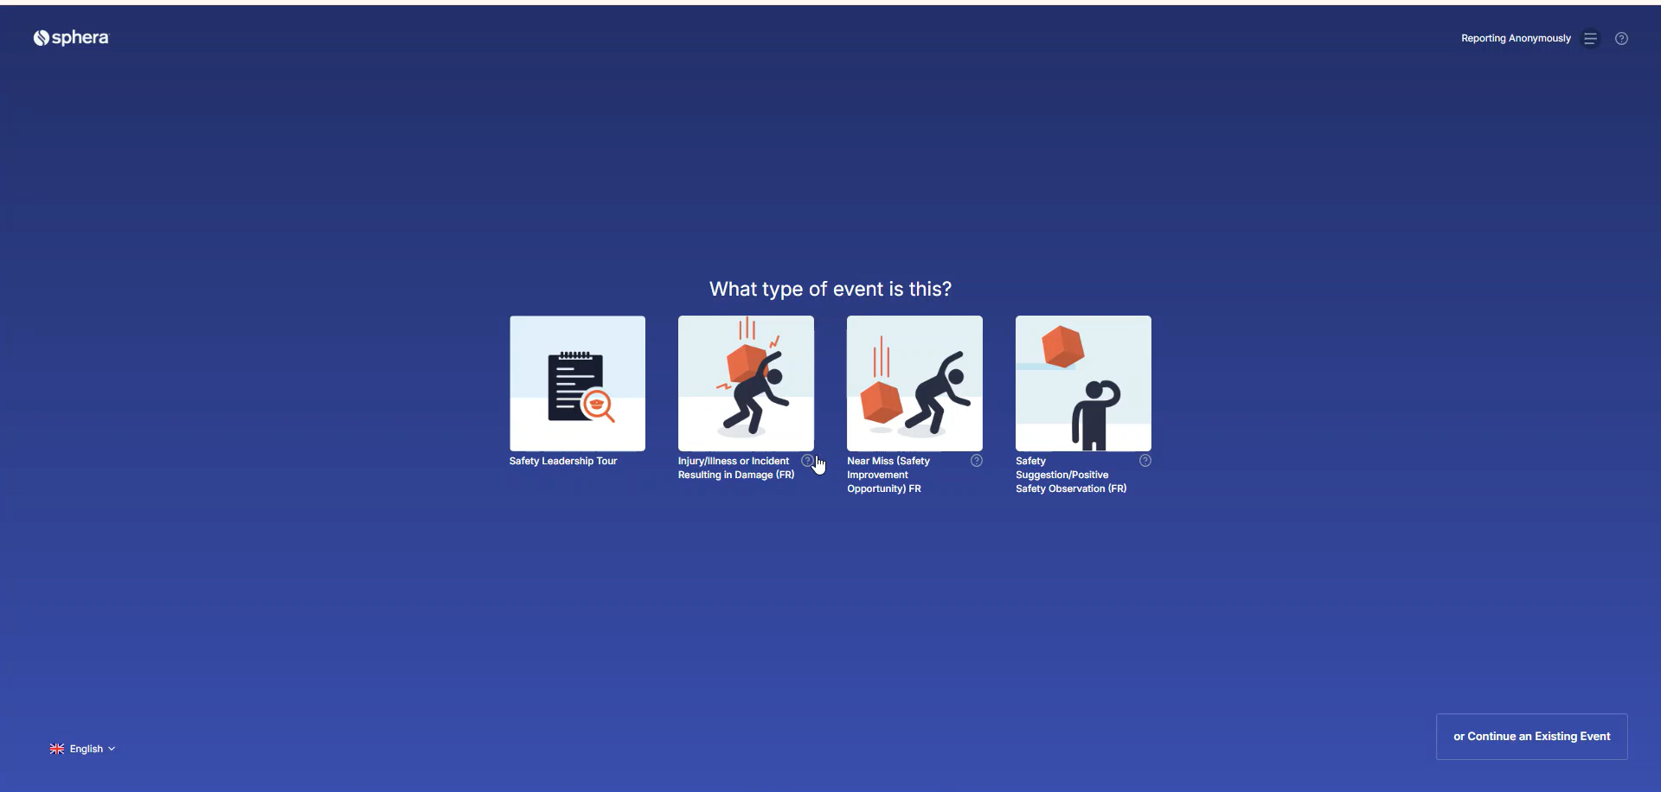
Adding a Safety Suggestion/Positive Safety Observation for unlicensed users
2. Selecting the correct module
Loading the first report screen
Selecting the correct module
Filling in your details
Filling in the report
Review and submit
Once the website has loaded, select ‘Safety Suggestion/Positive Safety Observation’
Prev
Next

Slide 4
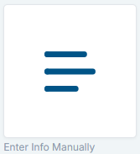
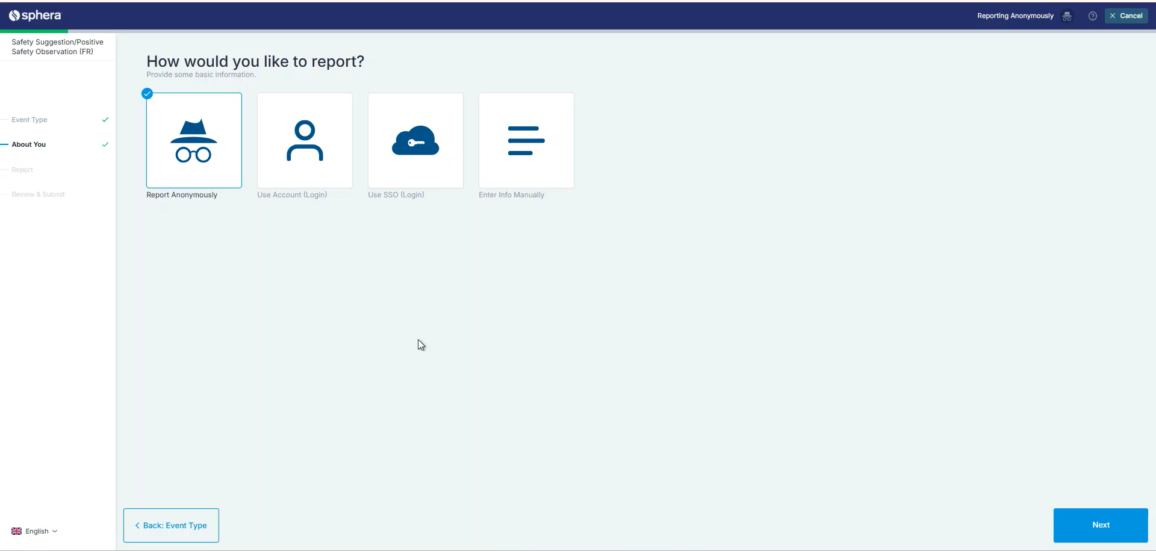
Adding a Safety Suggestion/Positive Safety Observation for unlicensed users
3. Filling in your details
Loading the first report screen
Selecting the correct module
Filling in your details
Filling in the report
Review and submit
When you arrive at the ‘How would you like to report?’ screen:
1. Click ‘Enter Info Manually’
2. Enter your name. DO NOT INSERT ANYTHING INTO 'Email’ OR 'Phone Number'
3. Click 'Next'
Prev
Next

Slide 5
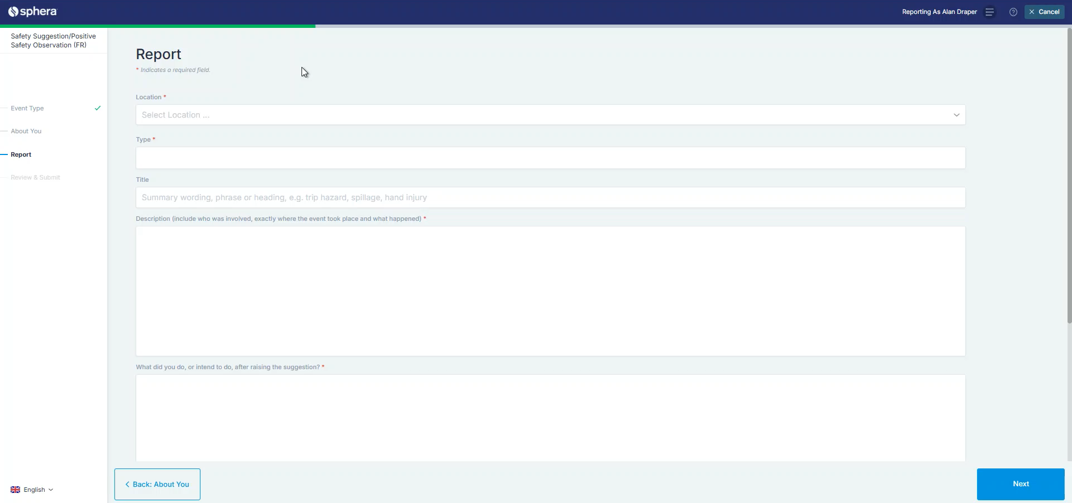
Adding a Safety Suggestion/Positive Safety Observation for unlicensed users
4. Filling in the report
Loading the first report screen
Selecting the correct module
Filling in your details
Filling in the report
Review and submit
Go ahead and fill in the necessary fields in the form.
Location: | Your site location
Specific Location: | The Department within the location
Type: | Safety Suggestion: ie; inadequate guarding which has not yet become a near miss. Positive Safety Observation: ie; good use of PPE or a best practice which has worked well. Please do not select 'Continuous Improvement' unless your site is authorised to use this.
Prev
Next

Slide 6
Adding a Safety Suggestion/Positive Safety Observation for unlicensed users
4. Filling in the report
Loading the first report screen
Selecting the correct module
Filling in your details
Filling in the report
Review and submit
Go ahead and fill in the necessary fields in the form.
Title: | A general view of the observation
Description: | An in-depth detailed description
What did you do, or intend to do, after raising the suggestion?: | Did you contact a manager or supervisor? Did you make safe a potentially hazardous arrangement?
If this was reported to you, who was it?: | If you were not the first person to see the event, who was it?
Prev
Next

Slide 7
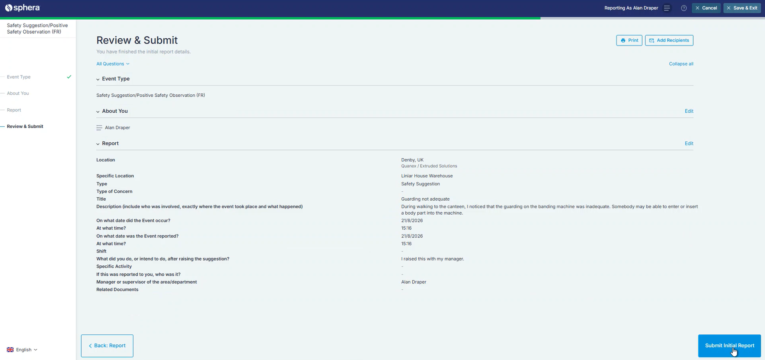
Adding a Safety Observation for unlicensed users
5. Review and Submit
Loading the first report screen
Selecting the correct module
Filling in your details
Filling in the report
Review and submit
You will be given an overview of your submission.
To complete, press ‘Submit Initial Report’
Prev
Next

